Slide 1
By: Partha Sarathi Kundu WSUID: X475M573
Big Data Analytics in Engineering Final Project Showcase
Topic: Enhance Business Strategy with Sentiment Analysis Sub-topic: Data-Driven Insights for Promotion Optimization Dataset: Walmart-extended-dataset

Slide 2
Introduction
Objective:
Explore the role of sentiment analysis and satisfaction scores in predicting customer purchase likelihood.
Guide business strategy on promotions using data-driven insights.
Scope:
Analyze customer reviews, satisfaction scores, and purchase patterns.
Develop actionable strategies based on sentiment trends.
Design Future-proof dynamic data-driven solution.

Slide 3
Data Overview
Dataset Description:
3 different datasets, 33 combined columns
55,000 records of customer reviews, purchases, promotion and satisfaction scores.
Key variables: Sentiments (Review & Reply), DiscountPercentage, EngagementMetric, CustomerInteraction, ConditionalPromotions and Purchase.
Goal:
Perform extensive EDA, Feature enrichment and data Normalization
Analyse customer sentiments to identify trends
Purchase behavior based on Sentiment analysis
Correlations to optimize promotion strategies for business profit

Slide 4
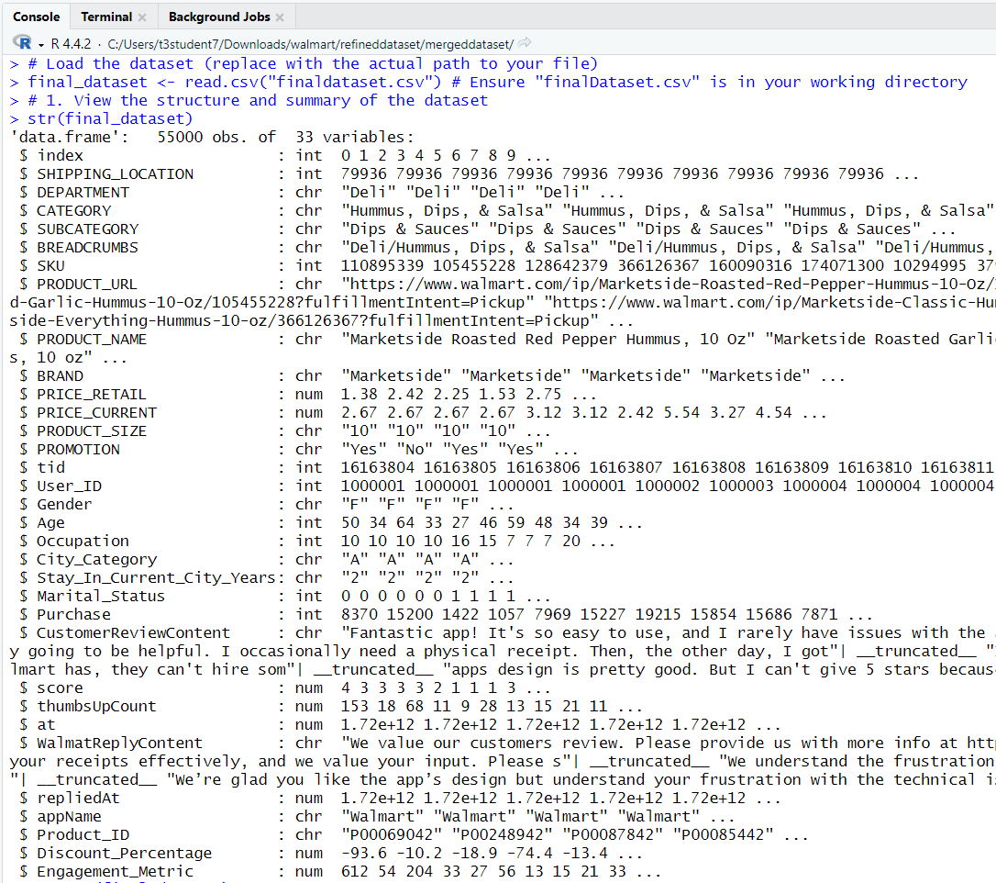
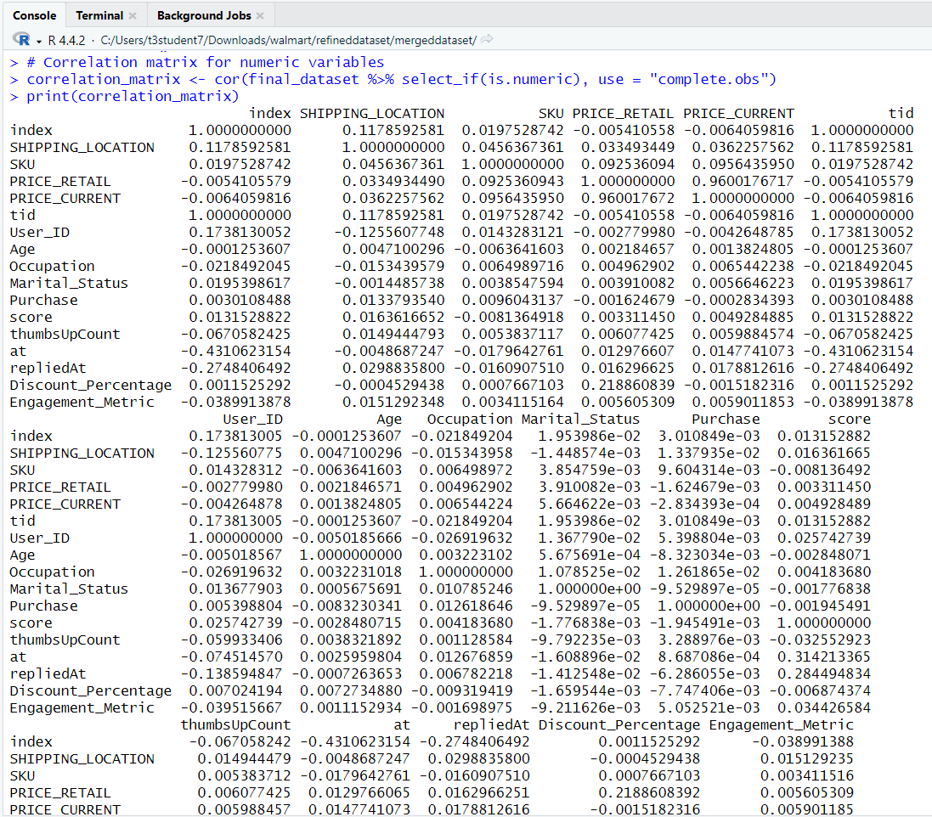
Data Overview [Con.]

Slide 5
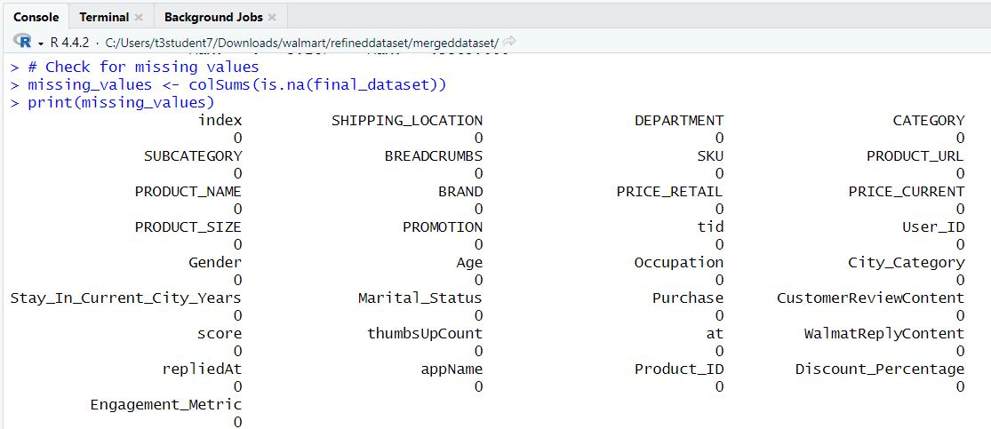
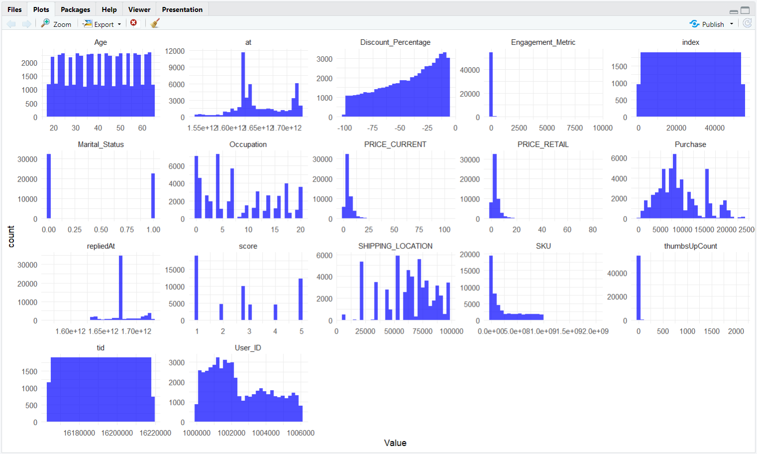
Data Overview [Con.]
Key Points:
Uniform Distributions:
Variables like Age and Marital_Status show uniform or binary distributions, indicating diverse demographics and clear categories.
Skewed Variables:
Variables like PRICE_CURRENT, thumbsUpCount, and Engagement_Metric are highly skewed, with most values near zero, indicating limited high-value interactions or outliers.
Purchase Patterns:
Purchase shows a bell-shaped distribution with a peak in the mid-range, suggesting most purchases cluster around average amounts.
Discount Impact:
Discounts are heavily skewed toward significant negative values, highlighting aggressive pricing strategies.
Satisfaction (score):
Scores are discrete and lean toward mid-to-high values, indicating general customer satisfaction.

Slide 6
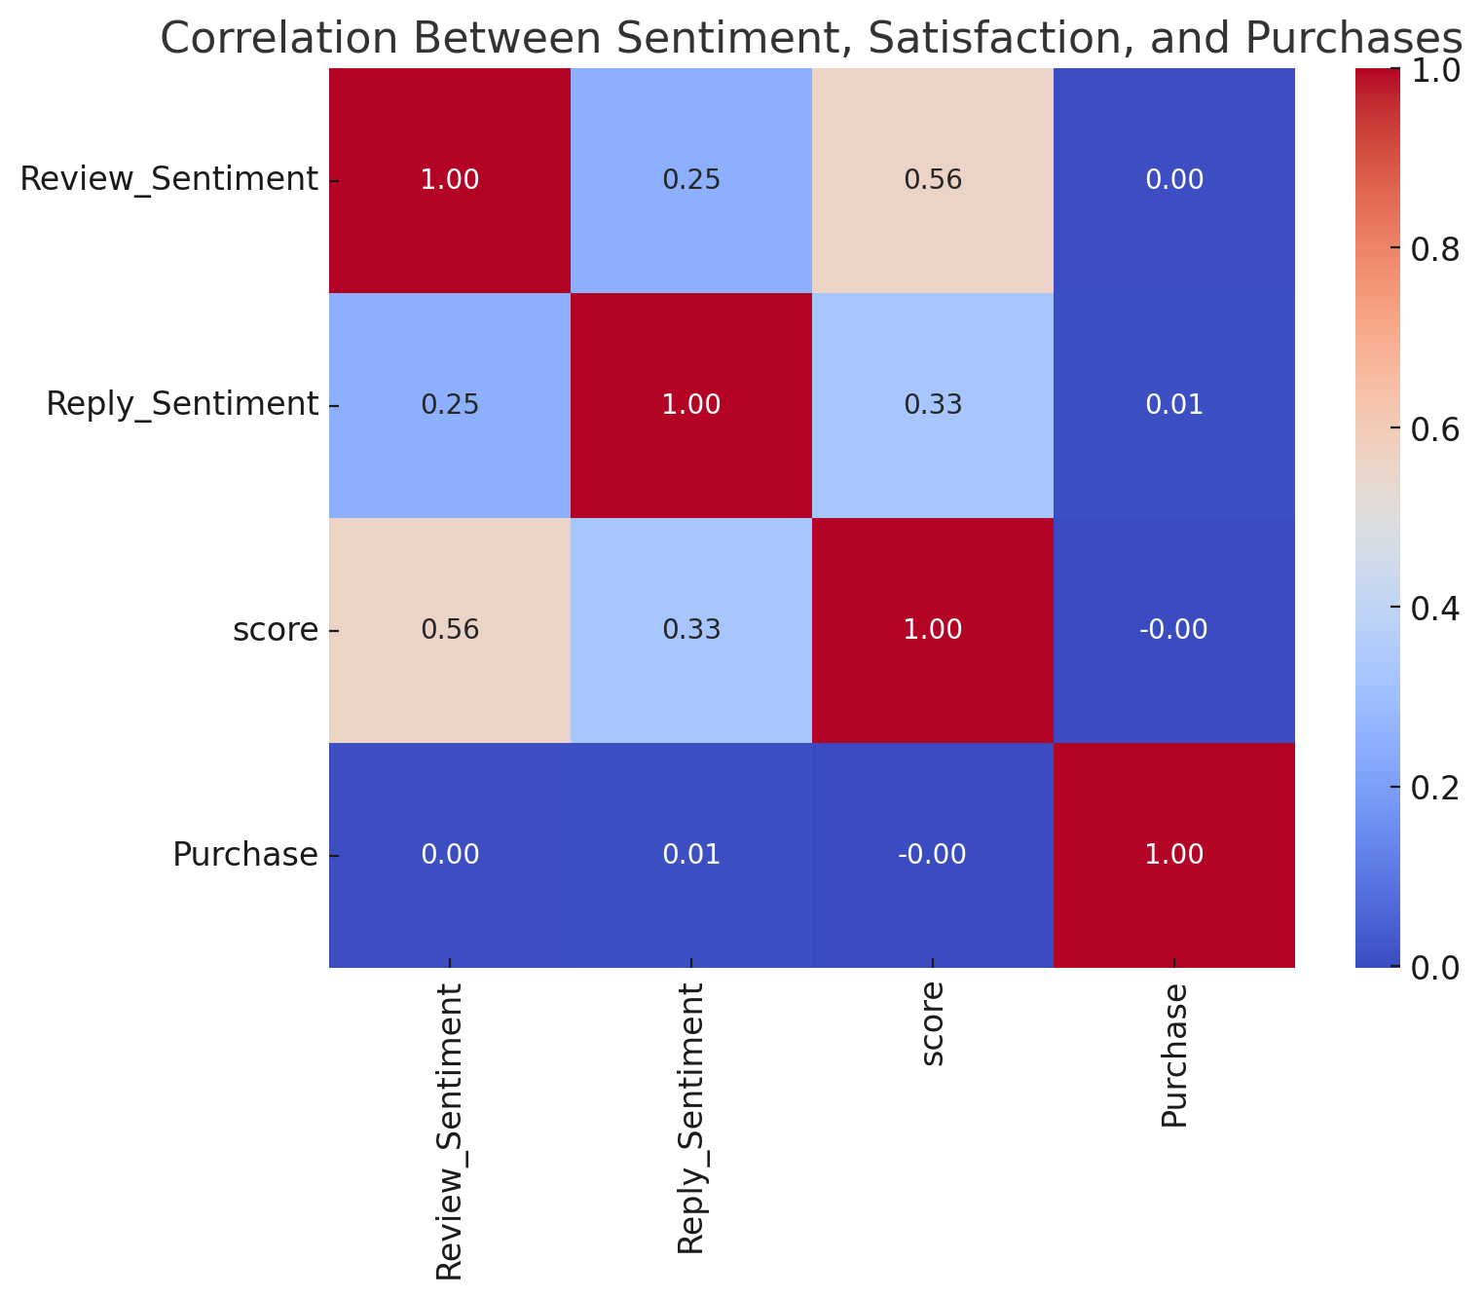
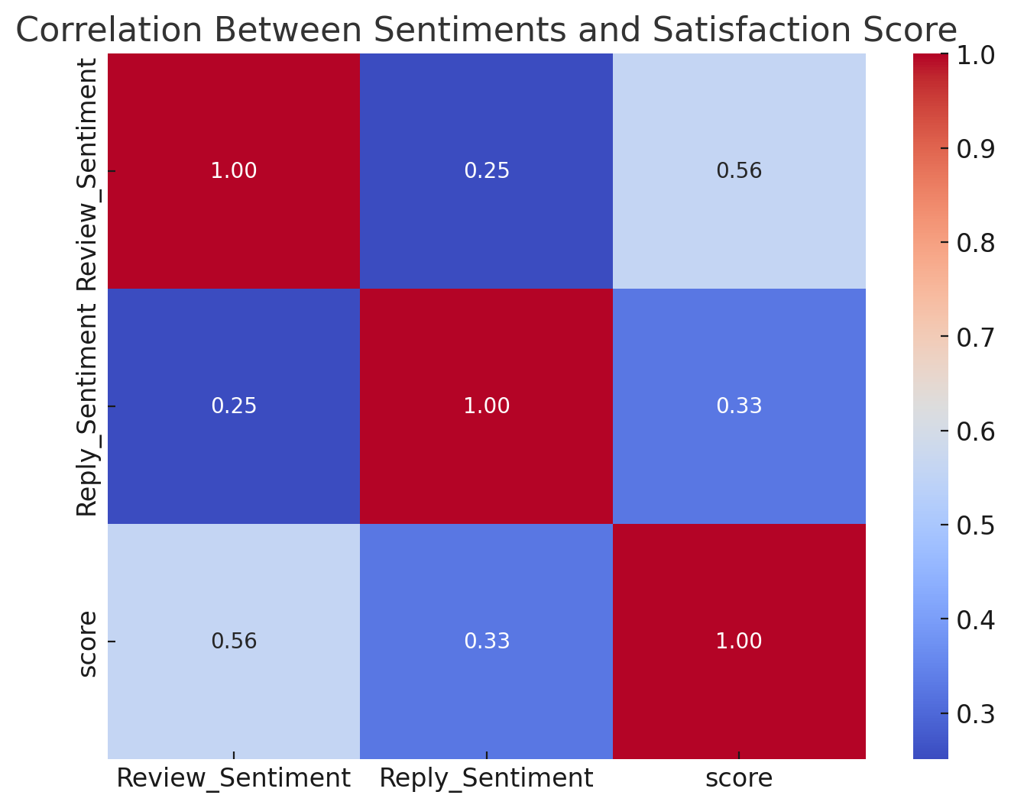
Key Analysis Correlation Heatmap between features customer sentiments and interaction score
Takeaway: Satisfaction and sentiment indirectly influence purchases but play a role in engagement.
Takeaway: Positive reviews are moderately linked to higher customer satisfaction (correlation: 0.56).
Replies from Walmart have a weaker impact on satisfaction (correlation: 0.33) compared to reviews.

Slide 7
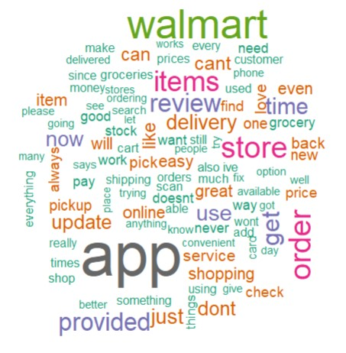
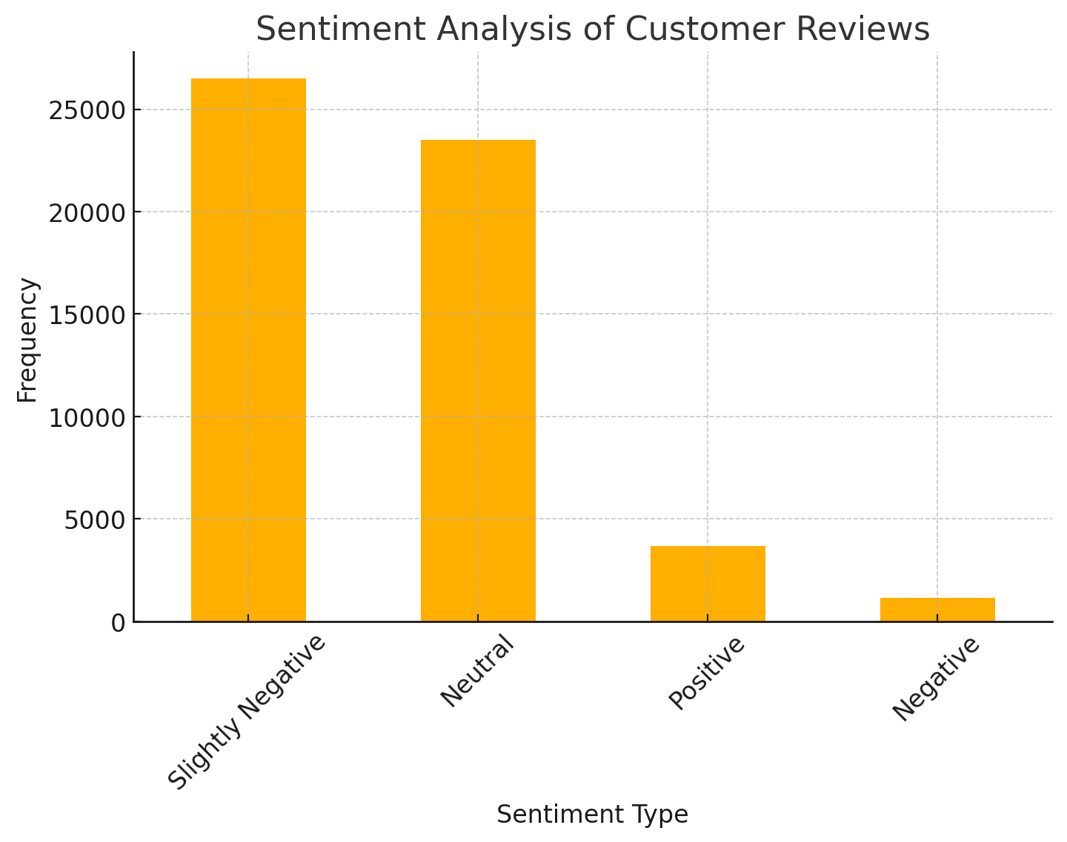
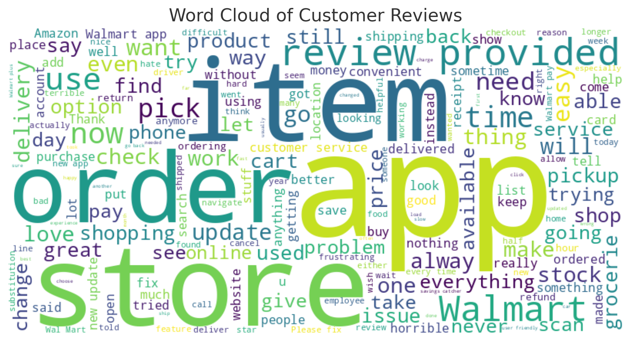
Key Analysis [Con.] Review text mining and WordCloud, Text Mining for Sentiment analysis
Observations:
The majority of reviews lean towards neutral or slightly negative tones, suggesting mixed customer experiences.
Positive reviews are less common, indicating potential gaps in customer satisfaction or areas where improvements could boost favorable feedback.
Fig: Customer review text mining and Positive/Neutral Sentiment Word Cloud

Slide 8
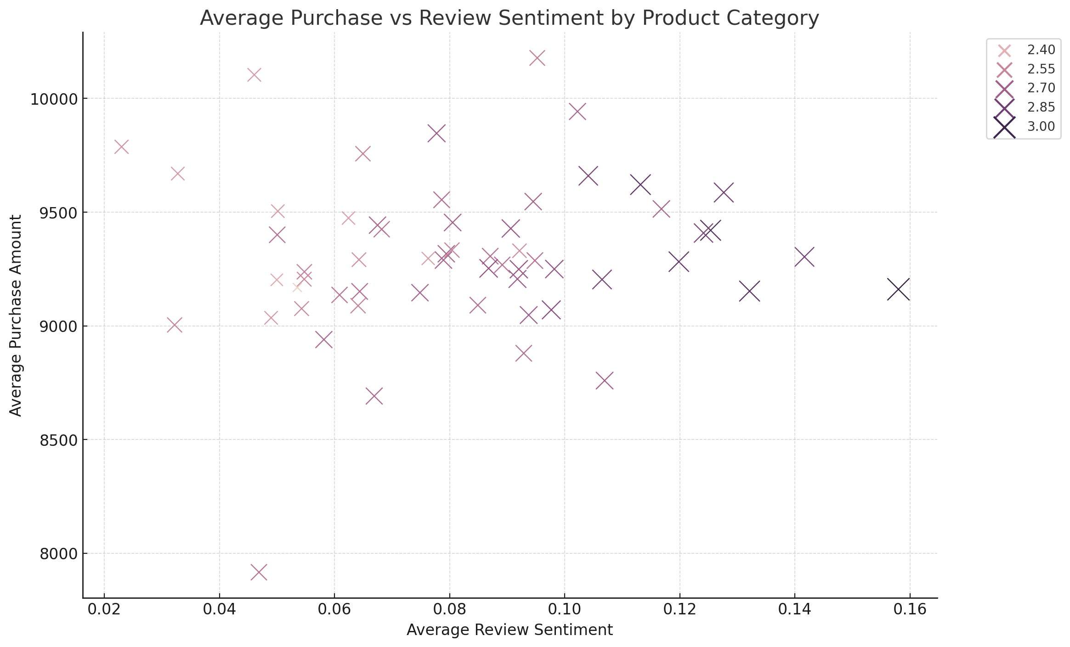
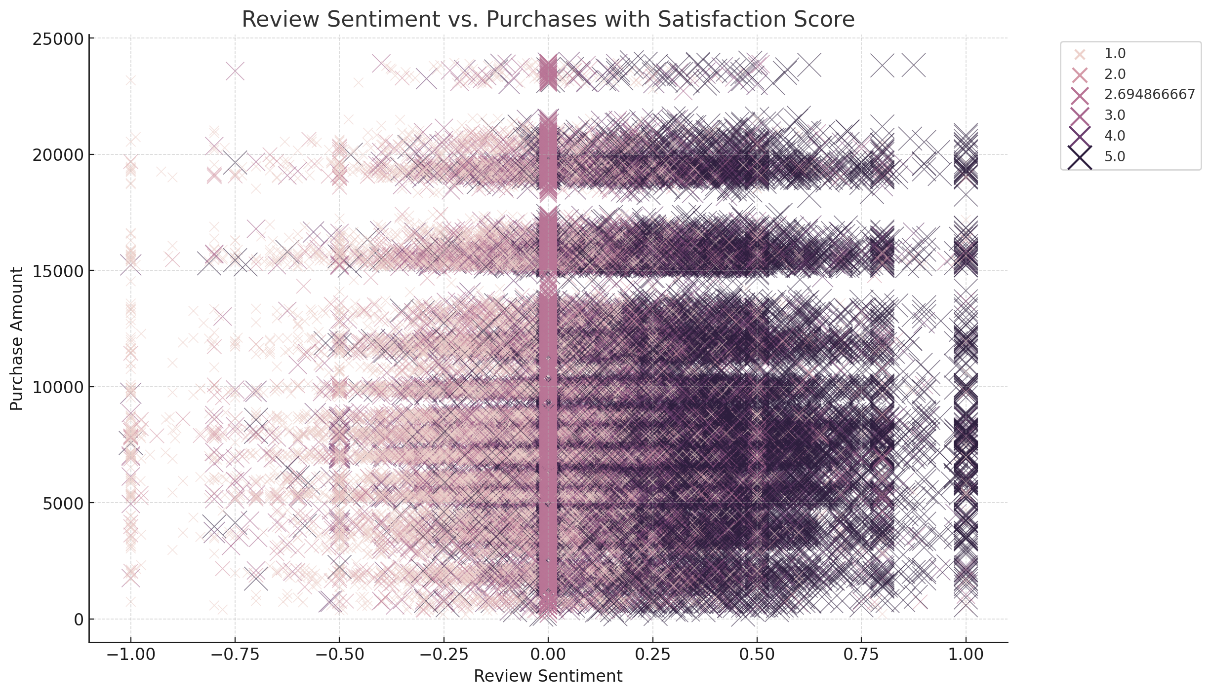
Key Analysis [Con.] Relationship between Sentiment and Purchase Trends
Observation:
As review sentiment becomes more positive, average purchase amounts tend to increase for some product categories.
Categories with higher review sentiment are associated with slightly higher satisfaction scores.
Key Takeaway:
Positive customer sentiment aligns with higher purchases in specific categories, indicating sentiment as a driver for purchase behavior.
Observation:
The plot shows a wide distribution of purchase amounts across the range of review sentiments.
Neutral sentiment (close to 0) has significant overlap with varying purchase levels, while extremely positive or negative sentiments show fewer data points. Satisfaction scores (size of points) increase slightly with more positive sentiments.
Key Takeaway:
While positive sentiments may slightly align with higher purchase amounts, the impact is less distinct for neutral or slightly negative sentiments.

Slide 9
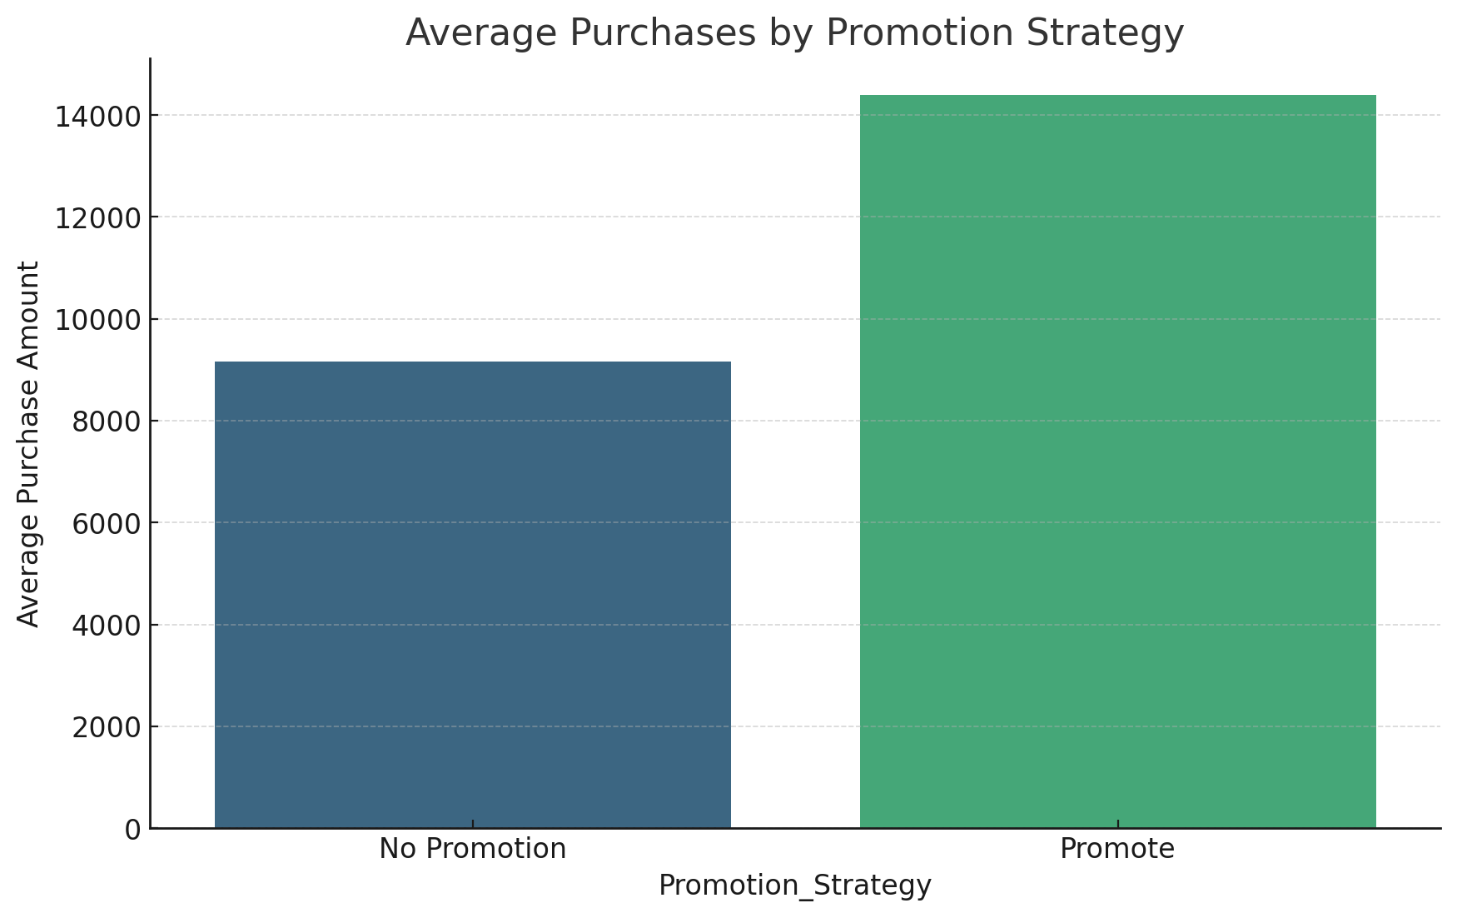
Data driven Strategy and Decision Average Purchases by Promotion Strategy
Target Products for Promotion:
Focus on high-sentiment, high-satisfaction products with untapped potential.
Address Neutral/Negative Sentiment:
Use promotions to re-engage customers and improve sentiment.
Optimize Messaging:
Tailor promotional campaigns based on customer feedback (e.g., emphasize affordability or quality).
Track Promotion Effectiveness:
Use sentiment analysis pre- and post-promotion to measure success.
Business Strategy Guidance:
Promotion Focus: Target products in the "Promote" category. Promotions can enhance existing customer engagement and maximize ROI.
Improve Strategy for "No Promotion" Products: Investigate why these products underperform (e.g., lower satisfaction or sentiment) and address root causes before applying promotions.
Observation:
Products categorized into:
Promote: High sentiment, high satisfaction, and above-average purchases.
No Promotion: Lower sentiment or satisfaction.
Results: "Promote" products show significantly higher purchase amounts.
Action Point: Allocate resources to promote high-sentiment products to maximize ROI.

Slide 10
Business Impact & Future Improvements Streamline benefits of Sentiment-Based Promotions and Automation
Business Benefits:
Improved customer engagement.
Increased sales for underperforming yet positively reviewed products.
Enhanced customer trust and loyalty through personalized strategies.
Boost Revenue with Sentiment-Based Promotions:
Target high-sentiment products for maximum ROI and address low-sentiment products to re-engage customers.
Enhance Customer Trust and Retention:
Use sentiment insights to resolve customer concerns and deliver personalized, impactful promotions.
Automation is the Future!
Automate Sentiment Analysis for Efficiency:
Real-time monitoring and predictive analytics streamline promotions and resource allocation.
Create Dynamic Promotion Strategies.
Integrated Feedback Loops for 2-way communication.
Cross-Channel Personalization for accessibility and inclusion.
Deploy Agentic AI to reduce waste on ineffective campaigns and promotions.

Slide 11
Data References & Code Repository
Data Reference
https://www.kaggle.com/datasets/thedevastator/product-prices-and-sizes-from-walmart-grocery
https://www.kaggle.com/datasets/devarajv88/walmart-sales-dataset
https://www.kaggle.com/datasets/bleuarmendariz/walmart-employee-reviews
finaldataset.csv
Code Repo
finalCode

Slide 12
Thank you all. Feedback, Questions & Discussion.

